Slide 1

PARAPHRASE DETECTION
Team Members:
Mahesh gundagoni
Sreeja garlapati
Bharath kondreddy

Slide 2
Introduction
This project's goal is to develop an intelligent system that can recognize with precision if two statements are paraphrases of one another.
Enhance applications of natural language processing by improving the comprehension of sentence similarity.
For this a robust dataset consisting of sentences which are paraphrased and not, which are labeled either as 0 or 1.
A well-functioning paraphrase detection system enhances comprehension of the text by locating synonyms. Chatbots, recommendation engines, and search results with more accuracy are beneficial to users.

Slide 3
Data Acquisition & Preparation
The Paraphrase Detection dataset from Kaggle, which in default split into train, test and validation which was imported using a Kaggle API command, This method allows for efficient data handling and batching during the training process
Later the data was loaded to a data frame and the null value inspection was conducted, for a better training of model all the null rows were dropped.
The training dataset was shuffled with a buffer size of 10,000 and batched with a batch size of 64. This approach is essential for training efficiency and to ensure randomization in the training process.

Slide 4
Model Training
The model selected for the project was BERT (Bidirectional Encoder Representations from Transformers). Specifically, a small BERT model with an uncased vocabulary (small_bert/bert_en_uncased_L-4_H-512_A-8) was chosen from TensorFlow Hub. This model is a lighter version of the original BERT, suitable for less resource-intensive environments
A classifier model was built using TensorFlow Keras. The model architecture included BERT as the encoder with a preprocessing layer, a dropout layer for regularization, and a dense layer for output. The classifier model was then trained to identify if two sentences are paraphrases of each other .
The classifier model was trained for 10 epochs. Throughout the training process, metrics such as binary accuracy and F1 score were monitored for both training and validation datasets. The model showed steady improvement in both accuracy and F1 score across epoch

Slide 5
Model Evaluation
After the rigorous training, the evaluation metrics are defined over to the model to verify its efficiency and what extent of better outcome it can provide.
The final evaluation on the test dataset revealed a binary accuracy of about 75.55% and an F1 score of approximately 81.44%. This indicates the model’s effectiveness in paraphrase detection, balancing both precision and recall.
The loss and Accuracy plots are shown in the following slide.

Slide 6
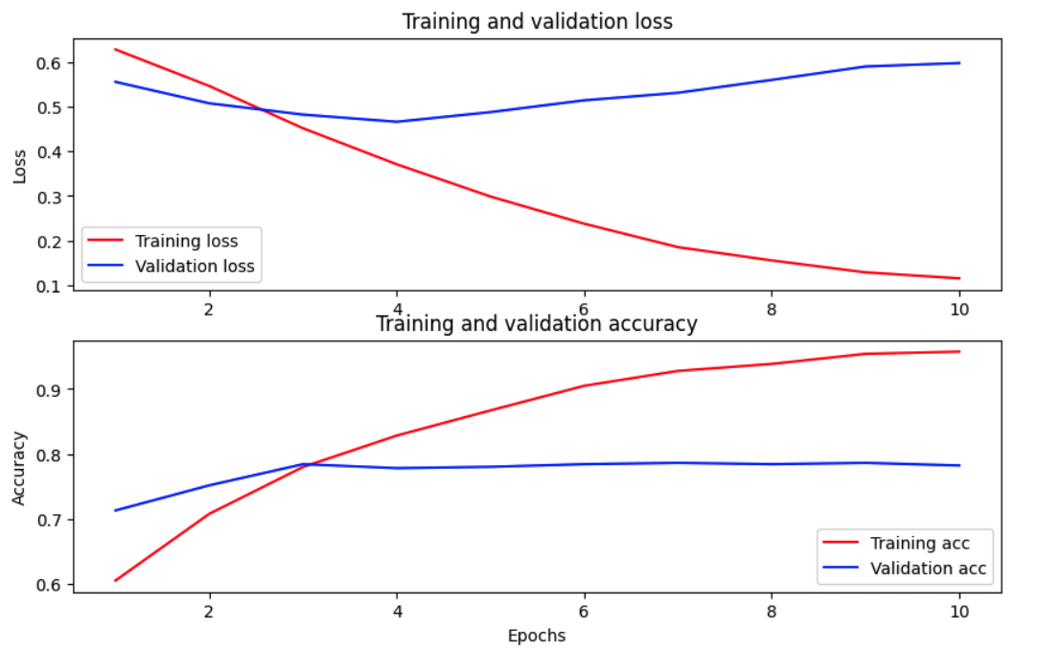
Loss and Accuracy Graphs

Slide 7
Conclusion
The Paraphrase Detection project successfully demonstrates the application of advanced natural language processing techniques using a BERT-based model for the task of identifying paraphrases in textual data. Key takeaways from the project include:
Effective Preprocessing
Model Selection and Architecture
Training and Performance
Paraphrase Detection project showcases a practical application of natural language processing, providing a foundation for further exploration and development in this rapidly evolving field.

Slide 8
Thank you

